Slide 2
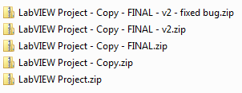
Source Code Control – Do I Need It?
Do I ever make a mistake?
Do my colleagues?
Really?
No
No
Yes
Yes
YES
BAD!
Notes:
Here is a handy flow chart to determine if your project can benefit from source code control.
For more details on source code control in LabVIEW, please see Eli Kerry’s Software Engineering Technical Manual and Exercises for LabVIEW: https://decibel.ni.com/content/docs/DOC-10122

Slide 3
Agenda
Introd
Notes:
Defining Agenda With Tanner

